Slide 1
State machines
State machines (DFA)
Regular expressions
State pattern
Literature:
Lecture note: RegExStateJava
http://www.tutorialspoint.com/java/java_regular_expressions.htm
http://docs.oracle.com/javase/tutorial/essential/regex/
http://www.sw-engineering-candies.com/blog-1/howtofindvalidemailaddresswitharegularexpressionregexinjava

Slide 2
Intended Learning Outcome
Can explain regular expressions.
Can use the Java Regex API for matching strings.
Can construct a state machine that recognizes (parses) a given regular expression.
Can apply State Pattern when implementing a state machine.

Slide 3
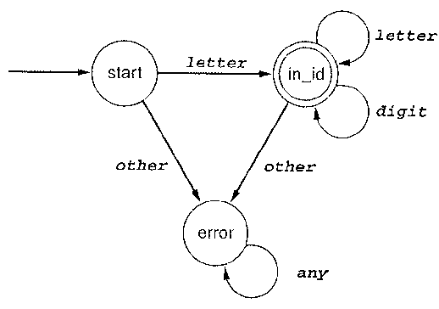
State Machines
A state machine or deterministic finite automata (DFA) is used for many purposes in computer science:
Recognizing patterns in strings
Scanning in compilers, browsers, …
Parsing protocols
Control and regulation of devices
Describing behaviour in games (AI)
Dialog box for editing parameters to a program
XML
Event handling in a windows system
And many more…

Slide 4
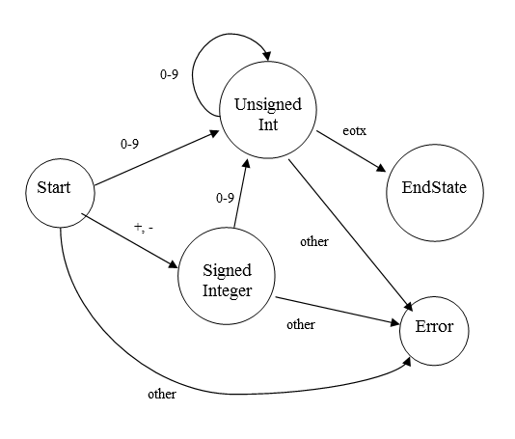
State Machines
There is a strong relationship between finite automata and regular expressions:
We can construct a finite automaton from a regular expression.
digit = [0-9] signedInt = (+|- ) ? digit+

Slide 5
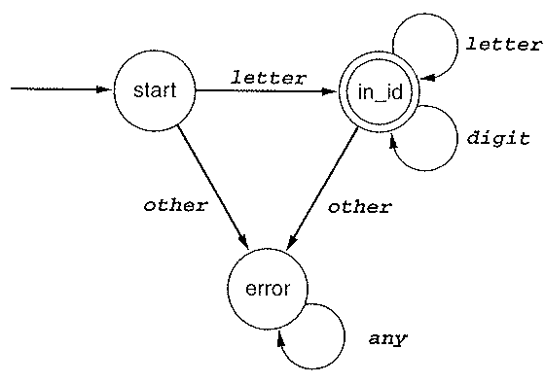
State Machines (Deterministic Finite Automata - DFA)
A DFA consist of an alphabet, a set of states, some transitions, a START state and some accepting states.
Accepting states represents the end of the recognition process.
DFAs are often defined by a state diagram.
A finite automaton for identifiers with error transition:
Accepting state:
double line

Slide 6
DFA defining Integers

Slide 7
Scanner Loop
Let’s try
input = +123
state:= start; error:= false;
while(not eotxt and not error)
if (exists transition from state marked with current input symbol)
state:= the state that this transition leads to
set current input to next symbol in the input sequence
else
error:= true;
endif;
endwhile;
if(error) report “error in input”; else report “input ok” endif

Slide 8
Implementations of DFAs
Choose an appropriate data structure to represent states:
A List or
A Map
A …?
0
i
n-1
states
s1
input
Find a way to implement the transition function:
A matrix perhaps
state
2
Much like a matrix implementation of a graph

Slide 9
OO Implementation
State is an object
State Pattern can be applied:
abstract class State specifies one or more abstract methods:
transition(-) – returns state corresponding to input symbol (or next event)
action(-) – if any processing is to be done when a transition occurs (code generation, event handling etc.)
each concrete state inherits from State and implements the abstract methods
The parser loop uses references having the abstract class State as static type.
Polymorphism and dynamic binding handles the rest!

Slide 10
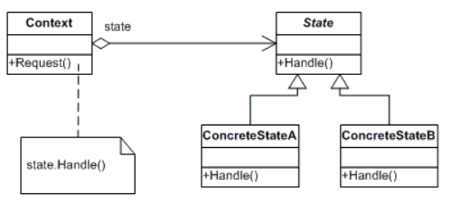
State Pattern
Implements state machines (DFA) encapsulating state. Provides addition of new states without changing existing code.
Implements the loop that gets next state and calls any operations connected to current state

Slide 11
The Classes of the Pattern
Context: Defines the objects that we want to maintain state information about (for instance DialogBox) . This class has a reference (static type: State – the abstract super class) to some concrete state (that is an object of one of the sub classes – dynamic type).
State: The abstract super class defining a common interface to all the concrete states.
ConcreteStateA,...: The sub classes to State. One sub class to each state in the DFA. The key to the design is in the handle-method, which takes an event as input and returns the next state.

Slide 12
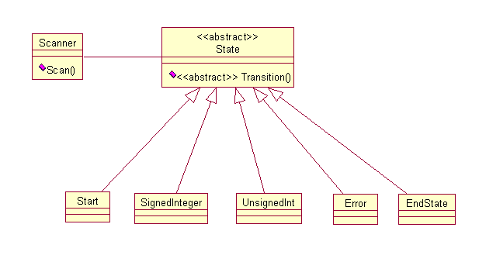
Signed Integer Recogniser

Slide 13
OO Parser Loop
//In class Scanner:
public boolean scan(String input) {
boolean ok = false;
int i = 0;
State currState = start;
while (currState != end && currState != err) {
char nextChar;
if (i == input.length()){
nextChar = '\0;’//represents ‘eotx’
}
else {
nextChar = input.charAt(i);
}
//currState.action();
currState = currState.transition(nextChar);
i++;
}
if (currState == end) {
ok = true;
}
return ok;
}
Let’s try
input = +123
View the Java Code

Slide 14
Exercises
Extend the state machine that recognizes integer, so decimal number also are recognized.
Implement the state machine using state pattern.

Slide 15
Regular Expressions
A regular expression is a pattern that describes a set of strings.
A regular expression is defined over some alphabet, Σ (Greek letter “sigma”).
An alphabet is a finite set of symbols.
For instance:
Σ = {a, b, c} – a very simple alphabet, only three symbols.
The empty string is denoted “ε” (Greek letter “epsilon”).

Slide 16
Regular Expressions
The set of regular expressions can be defined by the following recursive rules:
BASIS
ε is a regular expression
every symbol of ∑ is a regular expression
RECURSION (INDUCTION)
if r and s are regular expressions, so are
r | s -- or
rs -- concatenation
r* -- repetition, zero or more times
(r) -- grouping

Slide 17
Examples
a | b = {a, b} a | b | c | ε = {a, b, c, ε} a | b | . . . | z = {a, b, … z}
ab = {ab}
(a | b)c = {ac, bc}
a* = {ε, a, aa, aaa, aaaa, …}
(a | bb)* = {ε, a, bb, aa, abb, bba, bbbb, aaa , aabb, …}
Precedence Repetition has highest precedence, concatenation next highest and | is given the lowest. E.g. a | bc* means a | (b ( c*)) (redundant parenthesis may be a good idea).

Slide 18
Regular Expressions
Some other examples:
Let Σ = {a, b, c}. Consider the strings that contains exactly one b. (a | c)*b(a | c )* = {b, abc, abaca, … }
Consider the strings that contains at most one b (a | c)*b(a | c )* | (a | c)* = {ε, a, c, b, abc, abaca, … } or alternative (a | c)* (b | ε)(a | c )*
The same language may be generated by many different regular expressions. Usually, we try to find one as simple as possible!

Slide 19
Exercise
Write a regular expression for the set of strings consisting of all strings of a's and b's that end in abb. The alphabet is {a, b}.
Let Σ = {a, b, c}. Consider the strings that contains exactly one b ((a | c)*b(a | c )* ). Construct (draw the diagram) a state machine that recognizes this set of strings.
Notes:
3.
(a|b)*abb
4.
(a|c)*b(a|c)*

Slide 20
Regular Definition
It can be helpful to give names to long regular expressions (0 | 1 | 2 | … | 9) (0 | 1 | 2 | … | 9)* = {0, 1, 2, 3, …, 10, 11,…} or we could write: digit digit* where digit = 0 | 1 | 2 | … | 9

Slide 21
Regular Expression extensions
In the following we will describe some extensions to the standard regular expressions:
One or More instance ‘+’ (0 | 1 | 2 | … | 9)+ = {0, 1, 2, … 10, 11 ,12}
Zero or one instance ‘?’ a? means zero or one a
A range of Characters ‘[]’ [a-zA-Z] = a | b | … | z | A | B | … | Z [abc] = a | b | c
Any Character ‘.’ .*b.* means at least one b
Fixed number of iterations: b{3, 6} means at least 3 and at most 6 b’s
Any Character Not In a Given Set ^(a | b | c) means not either a or b or c.

Slide 22
Regular expressions in Java
Java provides the java.util.regex package for pattern matching with regular expressions.
The java.util.regex package primarily consists of the following three classes:
Pattern Class: A Pattern object is a compiled representation of a regular expression. To create a pattern, invoke one of its public static compile methods, which will then return a Pattern object. These methods accept a regular expression as the first argument.
Matcher Class: A Matcher object is the engine that interprets the pattern and performs match operations against an input string. You obtain a Matcher object by invoking the matcher method on a Pattern object.
PatternSyntaxException: A PatternSyntaxException object is an unchecked exception that indicates a syntax error in a regular expression pattern.

Slide 23
See it work:
What is defined her?
[a-zA-Z0-9._%+-]+@[a-zA-Z0-9.-]+\\.[a-zA-Z]{2,4}
See RegExDemo

Slide 24
public static void checkEmail() {
String email = "finn.nordb@jerg@gmail.com";
String emailPattern = "^[a-zA-Z0-9._%+-]+@[a-zA-Z0-9.-]+\\.[a-zA-Z]{2,4}$";
Pattern pattern = Pattern.compile(emailPattern);
Matcher m = pattern.matcher(email);
if(m.find())
System.out.println(email + " is ok");
else
System.out.println(email + " is not ok");
}
‘^’pattern means that the string must start with ‘foo’
pattern’$’ means that the string must end with ‘foo’.

Slide 25
Exercises
Use Regex to parse some of the following regular expressions
Typically, an identifier must start with a letter followed by letters and digits: letter = [a-zA-Z] digit = [0-9] identifier = letter(letter | digit)* Allow underscore(‘_’) in identifiers.
Numbers can be just a sequence of digits (natural numbers), integers (signed natural numbers) decimal numbers, numbers with exponents: nat = [0-9]+ signedNat = nat | -nat | +nat or signedNat = (+ | - )? nat number = signedNat(“.” nat)?(E signedNat)?
Use this link to investigate some more interesting properties of Regex: http://docs.oracle.com/javase/tutorial/essential/regex/index.html

Slide 26
Exercises
Implement the state machine that recognizes identifiers using state pattern.

Slide 27
State Pattern
An example not about scanning☺

Slide 28
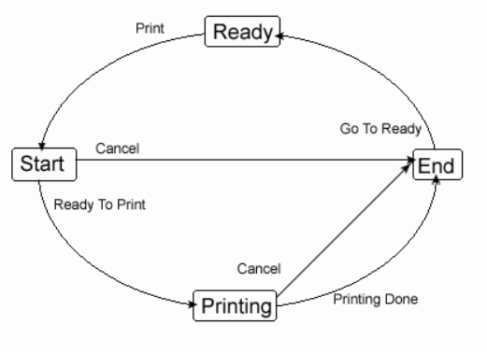
State Diagram (From: http://www.go4expert.com/forums/showthread.php?t=5127)

Slide 29
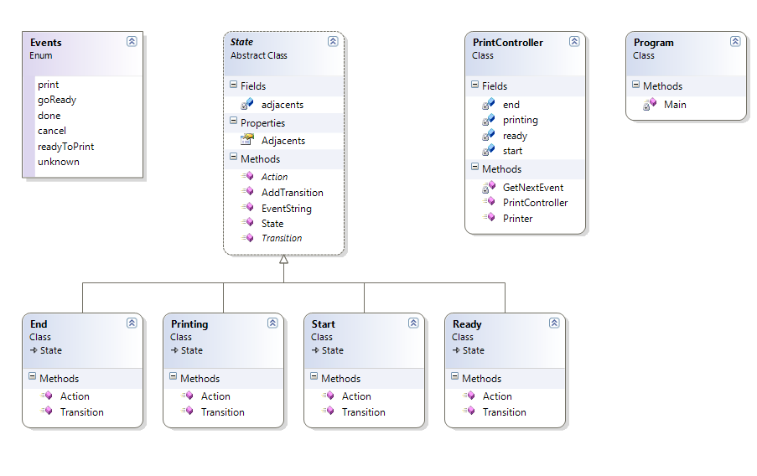
Class Diagram
Note: the same pattern:

Slide 30
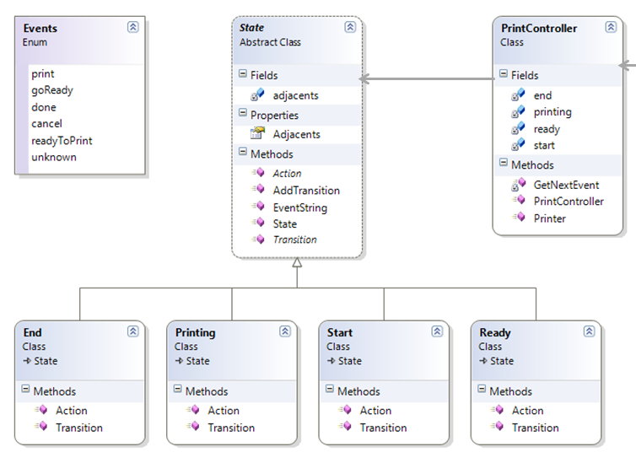

Note how the design reflects the structure of the state machine
View source
9. Exercise:
Add a new event: “Paper Jam”, which can occur in the state “Printing” and brings the printer in an error state where it remains stopped.

Slide 31
Intended Learning Outcomes (ILOs) Rank the ILOs from easy to the difficult. (Points: 1 = easy, 2 = medium, 3 = difficult).
ILO: | Score:
 | 1 | 2 | 3 | Total
Can explain regular expressions.
Can use the Java Regex API for matching strings.
Can construct a state machine that recognizes (parses) a given regular expression
Can apply State Pattern when implementing a state machine.

Slide 32
Exercise - extra
Construct a state machine that simulates the control of the soft drink vendor machine in the cafeteria.
Refactor the Integer and/or Decimal scanner, so that handling of states and transitions are done in the abstract class (see the PrinterStates demo).

